Slide 1

Playwright Browser Architecture
Understanding the hierarchy of Browser, BrowserContext, and Page objects is fundamental to effective Playwright automation. Each serves a distinct purpose in web testing architecture.

Slide 2

The Three Core Components
Browser
BrowserContext
Page
Heavyweight browser instance (Chromium, Firefox, WebKit). Created once per test suite. Supports headless or headed mode.
Isolated user session like incognito mode. Separate cookies, cache, storage. Multiple contexts per browser for parallel testing.
Individual tab within context. Where most interactions happen (click, fill, navigate). Multiple pages per context possible.

Slide 3

Hierarchy Structure
Page (1..n)
Browser Context (1..n)
Individual tabs or windows within each context for actual web interactions
Browser Instance
Multiple isolated sessions within the same browser, each with independent state
Single browser process launched with chromium.launch(), firefox.launch(), or webkit.launch()
const browser = await chromium.launch({ headless: false });const context = await browser.newContext();const page = await context.newPage();

Slide 4

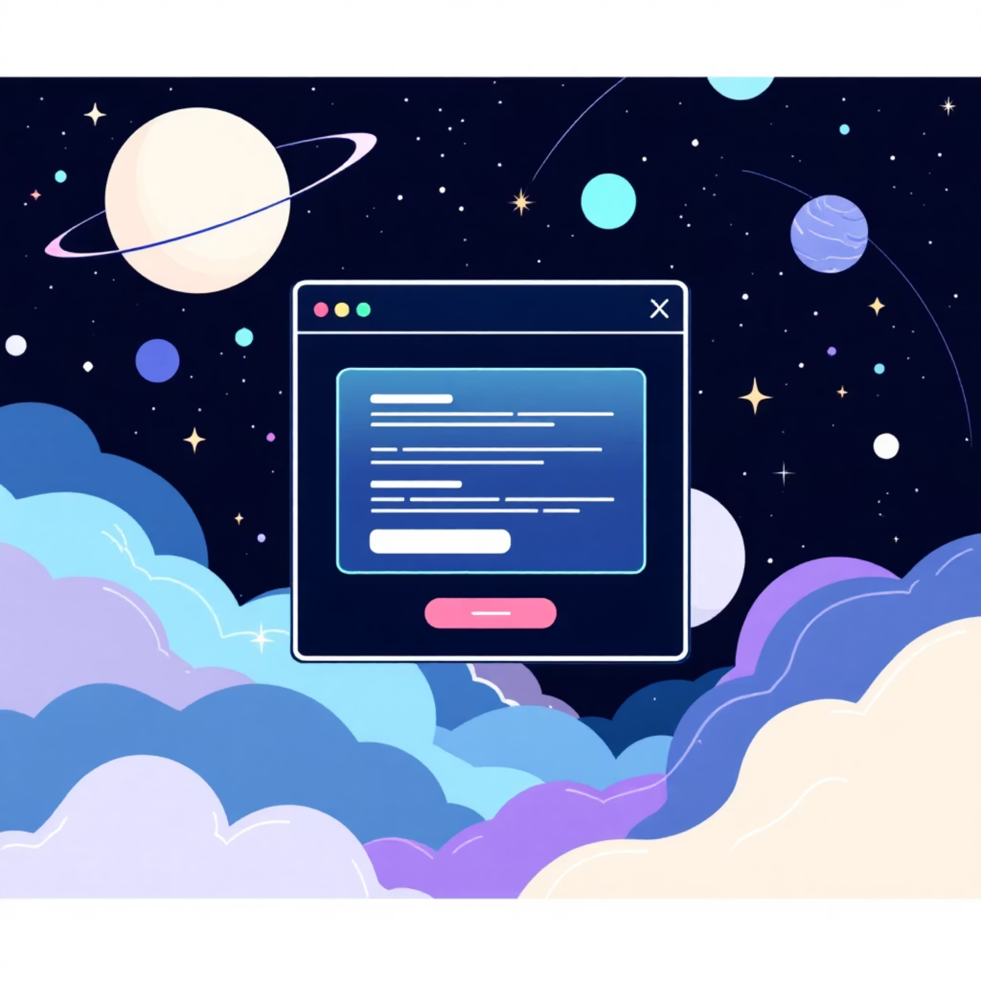
Handling Popups and New Pages
context.waitForEvent('page')
page.waitForEvent('popup')
Waits for new browser tabs or windows opened from the current context. Used for external links opening in new tabs.
Waits for popup windows that are children of the current page. Common for login popups or payment gateways.

Slide 5


Critical: Use Promise.all()
Common Mistake: Don't wait for events after clicking - the popup may already be missed!
Wrong Approach
Correct Approach
await page.click('#PopUp');const popup = await page.waitForEvent('popup'); // Too late!
await Promise.all([ page.waitForEvent('popup'), page.locator('#PopUp').click()]);
Promise.all() synchronizes both the event listener and user action, ensuring reliable popup handling in your Playwright tests.

